Slide 1
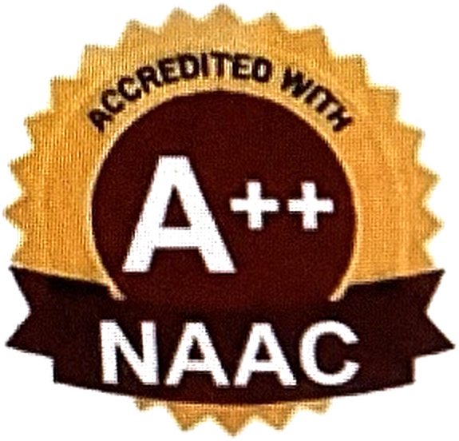

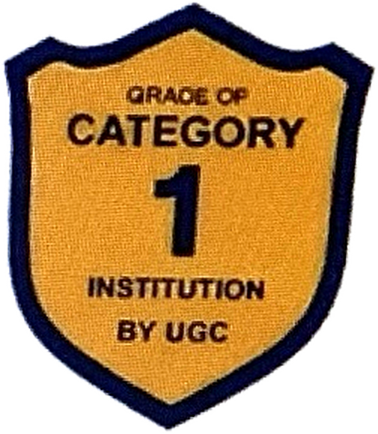
INSTITUTE OF SCIENCE, TECHNOLOGY & ADVANCED STUDIES (VISTAS)
(Deemed to be University Estd. u/s 3 of the UGC Act, 1956)
PALLAVARAM, THALAMBUR, PERIYAPALAYAM, THIRUVANMIYUR - CHENNAI
DEPARTMENT OF COMPUTER SCIENCE AND ENGINEERING (ARTIFICIAL INTELLIGENCE AND
MACHINE LEARNING)
CAREER BOOST AI: RESUME ANALYZER
TEAM MEMBERS
GUIDE NAME:
SHRUTHI .S
MS. DIVYA BHAIRAVI, M.E. (PHD)
SRIKANTH.R
ASSISTANT PROFESSOR
SUGASHINI.S
DEPARTMENT OF AIML
CLASS AND SEC:
B.Tech CSE AIML -B
DATE:

Slide 2
INTRODUCTION
A resume is an essential part of modern recruitment, presenting a candidate's education, skills, experience, projects, and certifications.
However, students and job seekers often find it difficult to understand whether their skills match the requirements of their desired career domain and what skills they need to develop, and traditional resume screening and keyword-based methods may not effectively identify skill gaps or provide personalized guidance.
To overcome these limitations, the proposed AI-powered web-based Resume Evaluation and Learning Assistant uses Natural Language Processing (NLP) and Machine Learning to analyse resumes according to a selected career domain, and the system identifies existing and missing skills, highlights career gaps, and recommends suitable learning resources and certifications, including free and premium options.
By combining resume evaluation with personalized learning guidance, the system helps users improve their skills and enhance their career readiness.

Slide 3
Students, graduates, and job seekers find it difficult to determine whether their skills match Many requirements of their desired career domain. Conventional resume screening mainly focuses on formatting and keyword matching, offering limited support for identifying skill gaps and career development needs. Career Boost AI is an AI-powered web-based Resume Evaluation and Learning Assistant that uses Natural Language Processing (NLP) and Machine Learning to analyse resumes based on a selected career domain. The system extracts relevant information such as education, technical skills, projects, certifications, and experience, identifies existing and missing skills, highlights career gaps, and recommends suitable learning resources and certifications. The proposed system provides personalized guidance to help users improve their skills and enhance their career readiness.
Keywords: Artificial Intelligence, Natural Language Processing, Machine Learning, Resume Evaluation, Skill Gap Analysis, Career Guidance, Course Recommendation.
ABSTRACT

Slide 4
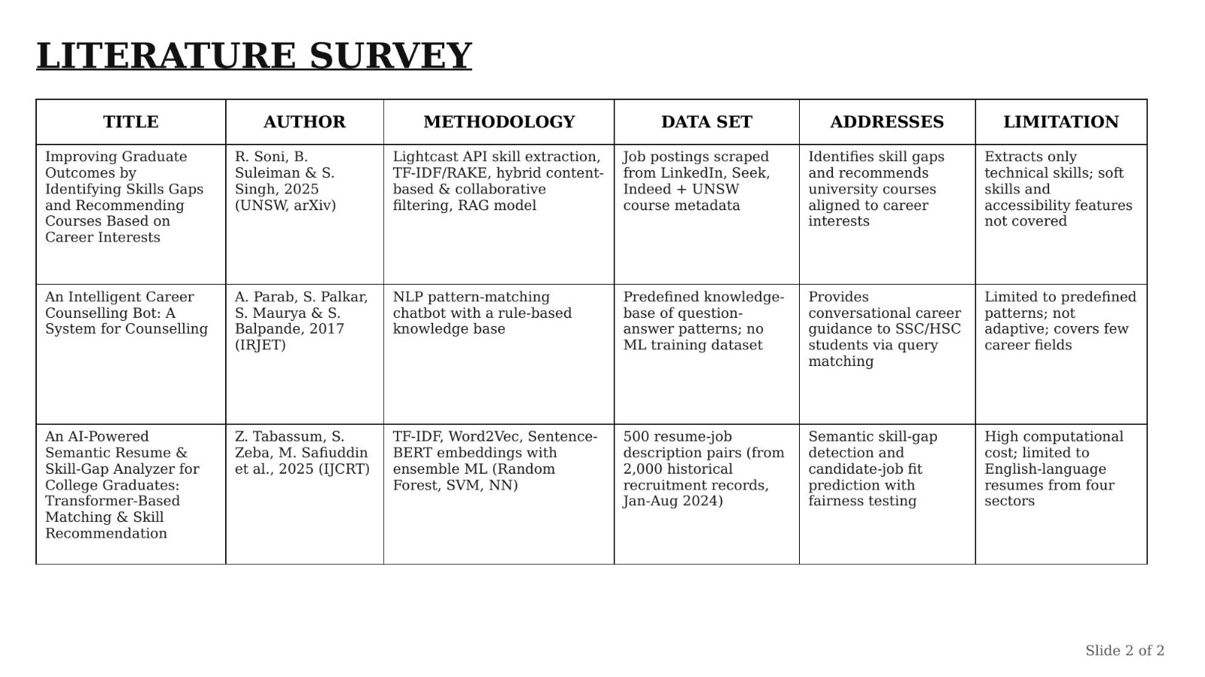

Slide 5
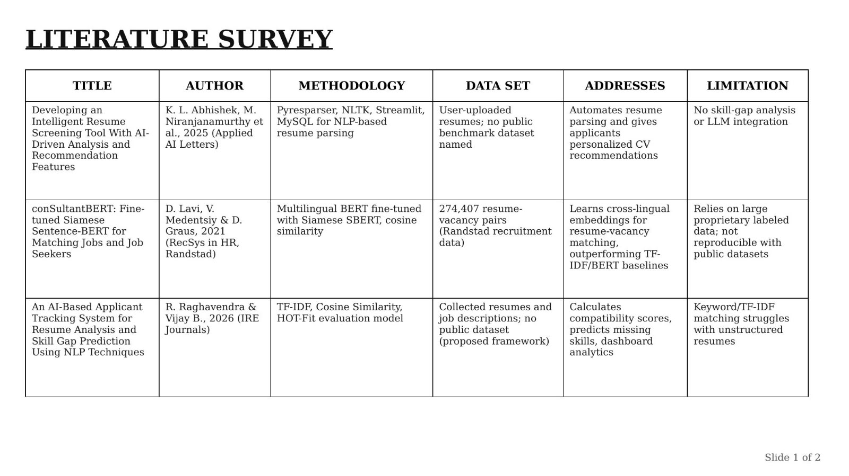

Slide 6
PROBLEM STATEMENT
Students and job seekers often struggle to identify the skills missing from their resumes for a desired career. Existing systems mainly focus on basic resume screening and keyword matching. Career Boost AI aims to identify skill gaps and provide suitable learning recommendations.

Slide 7
TECHNOLOGY STACK
Programming Language: Python 3.11/3.12
Frontend: HTML, CSS, JavaScript, Bootstrap
Backend: Flask
NLP: NLTK, spacys
Machine Learning: Scikit-learn, TF-IDF, Cosine Similarity
Semantic Matching: Sentence-BERT
Resume Parsing: Py MUPDF, python-docx
Database: MySQL
Visualization: Chart.js
Development Tool: VS Code

Slide 8
OBJECTIVE
To develop Career Boost AI for analysing resumes.
To extract skills, education, projects, experience and certifications from a resume.
To compare the resume with the requirements of a selected job role or career domain.
To find the matched skills and missing skills.
To calculate a skill matching score for the selected job role.
To suggest courses and learning resources for the missing skills.
To provide simple suggestions for improving the resume.

Slide 9
METHODOLOGY
The user first uploads a PDF or DOCX resume and selects a career domain or job role. The system extracts the resume text and performs NLP preprocessing to remove unnecessary content and identify relevant skills. The extracted skills are compared with the required skills of the selected job role using TF-IDF, Cosine Similarity and Sentence-BERT. The system then finds the matched and missing skills and calculates the matching score. Based on the missing skills, suitable courses and learning resources are recommended. The final results are displayed on a dashboard with the resume summary, skill match, skill gaps and recommendations.

Slide 10
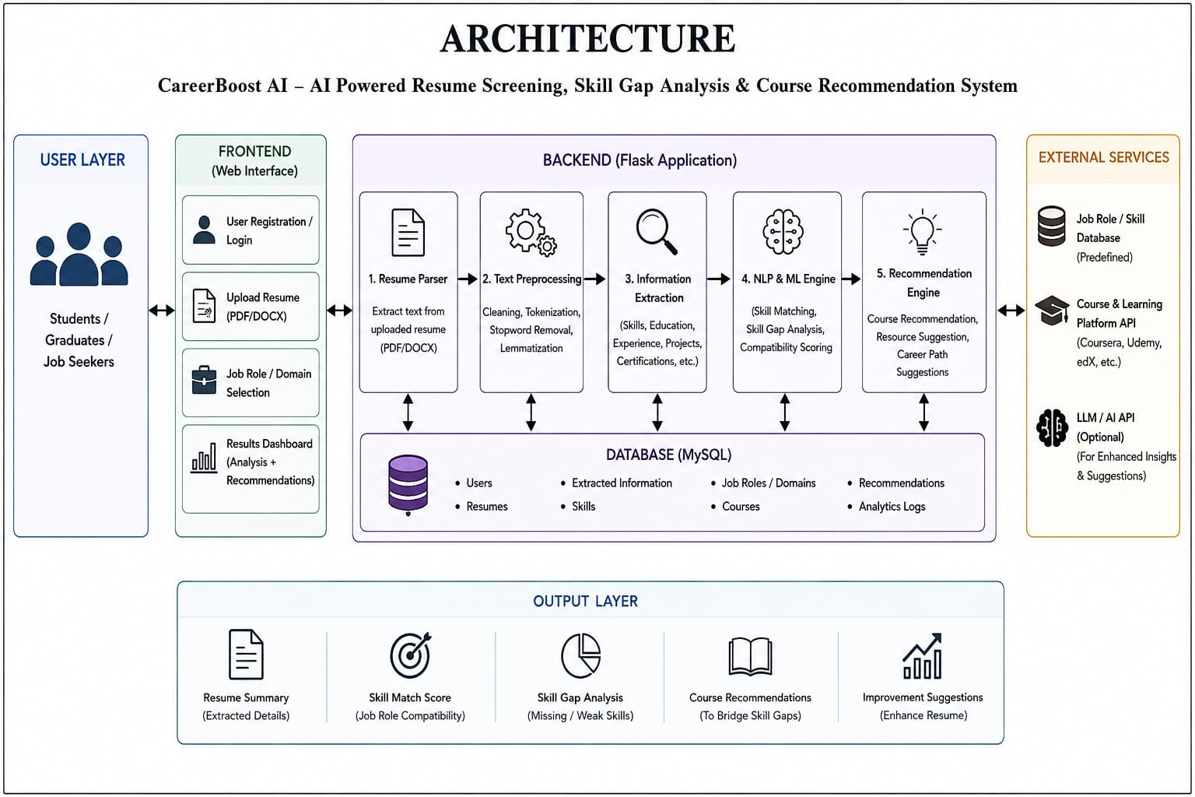

Slide 12
EXPECTED OUTCOME
The proposed Career Boost AI system is expected to:
Analyze resumes and identify relevant skills and qualifications.
Match the candidate’s skills with desired career-domain requirements.
Identify skill gaps and missing competencies.
Provide personalized resume improvement suggestions.
Recommend suitable courses and learning resources based on identified skill gaps.
Help students and job seekers improve their career readiness and job opportunities.

Slide 13
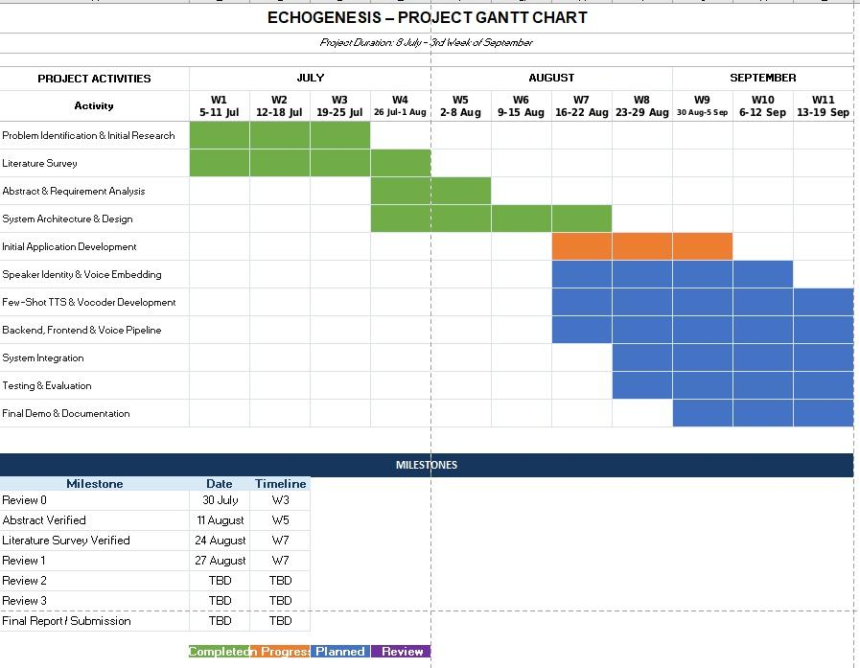

Slide 14
REFERENCE
Niranjanamurthy , S. Aric, S. I. Ansarullah, A. Sinha, G. Tejani, and M. A. Shah, "Developing an Intelligent Resume Screening Tool With AI-Driven Analysis and Recommendation Features," Applied AI Letters, vol. 6, no. 2, e116, 2025.
D. Lavi, V. Medentsiy , and D. Graus, “Consultant BERT: Fine-tuned Siamese Sentence-BERT for Matching Jobs and Job Seekers," in Proc. Rec SYS in HR 2021, Amsterdam, Netherlands, 2021.
R. Raghavendra and Vijay B., "An AI-Based Applicant Tracking System for Resume Analysis and Skill Gap Prediction Using NLP Techniques," IRE Journals, vol. 9, no. 11, 2026.
R. Soni, B. Suleiman, and S. Singh, "Improving Graduate Outcomes by Identifying Skills Gaps and Recommending Courses Based on Career Interests," School of Computer Science and Engineering, Univ. of New South Wales, arXiv:2511.09819, 2025.
A. Parab, S. Palkar, S. Maurya, and S. Balpande, "An Intelligent Career Counselling Bot: A System for Counselling," Int. Res. J. Eng. Technol. (IRJET), vol. 4, no. 3, pp. 2325–2330, 2017.
Z. Tabassum, S. Zeba, M. Safiuddin, M. Irfan, and F. A. A. Khan, "An AI-Powered Semantic Resume & Skill-Gap Analyzer for College Graduates: Transformer-Based Matching & Skill Recommendation," IJCRT, vol. 13, no. 11, 2025.

